Slide 1
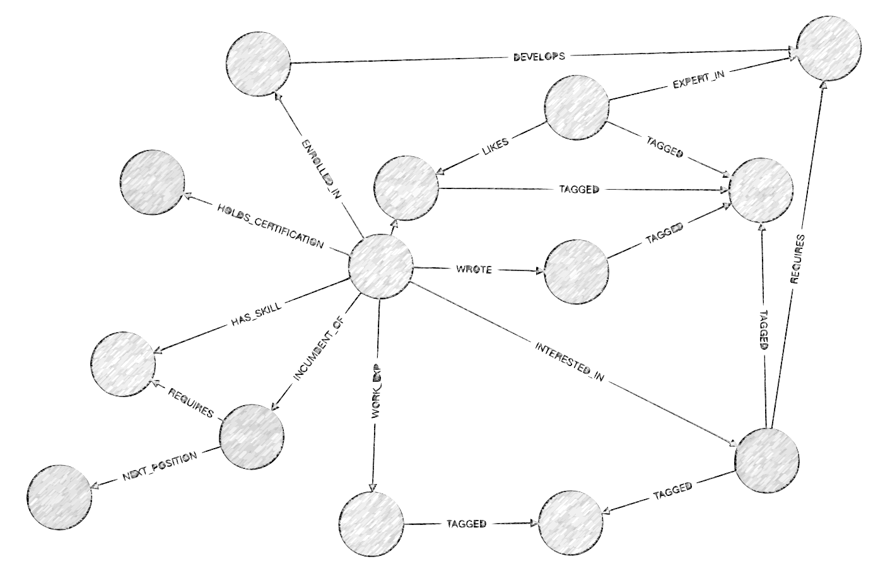
Talent Graph Strategy Plan

Slide 2


Introducing the Customers of the Talent Graph
Talented People with Limited-to-no Experience
University, Grant, or Hiring, Administrators
1
2
Frustrations:
Bias in Selection Processes
Lack of Experience
No structured way to show talent
Limited options for talent portfolio
No line of sight to different future scenarios – especially to ROI
Frustrations:
No structured way to asses talent when they don’t have experience leads to intended or unintended bias
Pressure to get the best
Paradoxical regulation
Time pressures
Financial pressures
Awareness of the imperfections and tradeoffs in the choice process
Inspirations:
Mentors
Teachers
Coaches
Friends
Artists and other Public Figures
A great future
Inspirations:
Applicants who are passionate
Applicants to have vision
Applicants that break the mold
Bets that pay off
Shared Problem: Bias | Shared Opportunity: Data

Slide 3
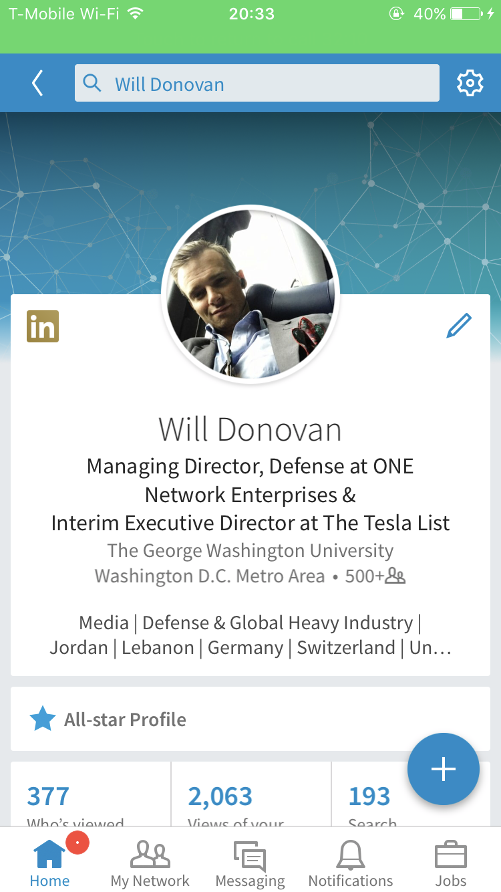
Unforeseen consequence of Social Media: It encourages Bias despite increased availability of Data
- “…whites who rely more on informal sources have higher wages than do whites who use formal sources, the opposite is true for black workforce”
“The level of publicly available data obtainable by employers is highly unstandardized across applicants…potential discrimination may result through employer’s access to publicly available pictures, videos, biographical information, or other shared information that often allows easy identification of applicant membership to a protected class.”
Experience is a “chicken and egg game”
The presence of bias in selection processes is well-known
Up to a third of U.S businesses are checking applicants out on social media early in the hiring process [..] before they ever get an interview
A 2009 survey conducted by CareerBuilder.com found that 45% of hiring managers reported searching social networking sites to learn about job candidates, an increase from the 22% reported from 2008.”
Social Media data includes age, race, gender, and can include sexual orientation, political perspective, etc.
Social Media vastly increases the amount of Applicant-Generated Content and Data that creates bias
Relative Age
Race
Gender
Experience but no listed Talents
Posts could be Political
Source: An Experiment in Hiring Discrimination Via online Social Networks
The Writing on the Facebook Wall: The use of Social Networking Sites in Hiring Decisions
Differences in Professional Informal Help Seeking Among Older African Americans, Black Caribbeans, and Non-Hispanic Whites
Notes:
http://www.jstor.org.ezproxy.neu.edu/stable/pdf/41837359.pdf?refreqid=excelsior%3Aa9109a22bcaa87ebea4be802f2aaff9f
http://www.jstor.org.ezproxy.neu.edu/stable/40604624?Search=yes&resultItemClick=true&searchText=job&searchText=bias&searchUri=%2Faction%2FdoBasicSearch%3Fso%3Drel%26amp%3Bacc%3Don%26amp%3Bwc%3Don%26amp%3Bhp%3D25%26amp%3Bfc%3Doff%26amp%3Bed%3D2017%26amp%3BQuery%3Djob%2Bbias%26amp%3Bpage%3D1%26amp%3Bprq%3Djob%2Bsearch%2Bbias%26amp%3Bsd%3D2000&refreqid=search%3A2bb85f866c3008a3975f72bcbcf876a5&seq=1#fndtn-page_scan_tab_contents
http://www.jstor.org.ezproxy.neu.edu/stable/pdf/42926618.pdf?refreqid=excelsior%3A68b210f96bd3ca4e5bc6c20774d5fe7f
https://papers.ssrn.com/sol3/papers.cfm?abstract_id=2031979

Slide 4
Those that use Social Media sites can expect intrinsic bias in their hiring process
Threats of Bias:
Examples of Bias
Definitions
Potential Mediations
Deviations from best reasoning and judgement lowers performance
Homogenous workplace limits creativity
Self selection occurs when individuals don’t apply for jobs they qualify… out of knowledge of the low possibility of getting the job
Accessing sources that simply confirmed their opinions without considering the opposite view, creating a vicious cycle of one sided views and lack of empathy for the other side
Development of unconscious bias – bias that we don’t even know we have
Conformity Bias
Taking cues from the actions of others rather than exercise our own independent judgment.
Perform statistical analysis that informs objective reasoning and can avoid group think
Beauty Bias
physically. attractive individuals are rewarded socially
Remove visuals and images during selection process
Affinity Bias
biased towards “people who make me comfortable” or “people who are like me,”
Move unconscious preferences to the surface and align them with objective goals and needs
Halo Effect
for an impression created in one area to influence opinion in another area
Utilize data-backed evidence and go through multivariate analysis to look across entire sample size
Similarity Bias
You hold a relatively positive perception of people who are similar to you
Move unconscious preferences to the surface and align them with objective goals and needs
Contrast Effect
the enhancement relative to normal as a result of exposure to a stimulus of the same dimension
Cluster candidates based on non-bias metrics, then use data driven talent model to differentiate candidate based on merit
Attribution Bias
systematic errors made when people try to find reasons for their own and others' behaviors
Perform statistical analysis that informs objective reasoning and can avoid group think

Slide 5
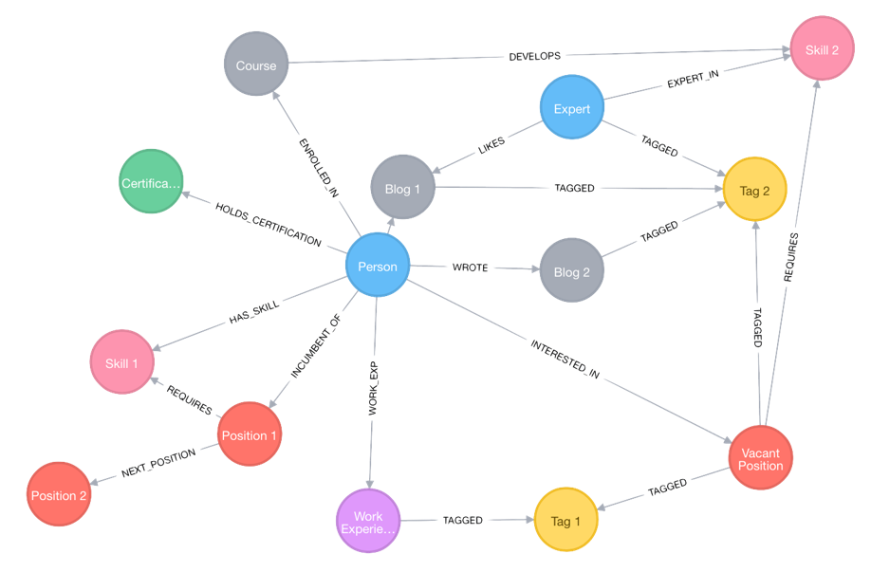
We propose: A Talent Graph strategy, addressing portability, predictability, flexibility and standardization
We need better data on talent, a better way of leveraging that data through learning-based approaches, and data-driven applications that help our two constituent groups.
Our approach allows for preservation and integrity of the data, completeness of the data and its narratives, while avoiding intrinsic and unconscious bias
Talent Graph Strategy
Reduce or Minimize…
BIAS
Enhance, Structure and Leverage…
DATA
Shared Problem: Bias | Shared Opportunity: Data

Slide 6
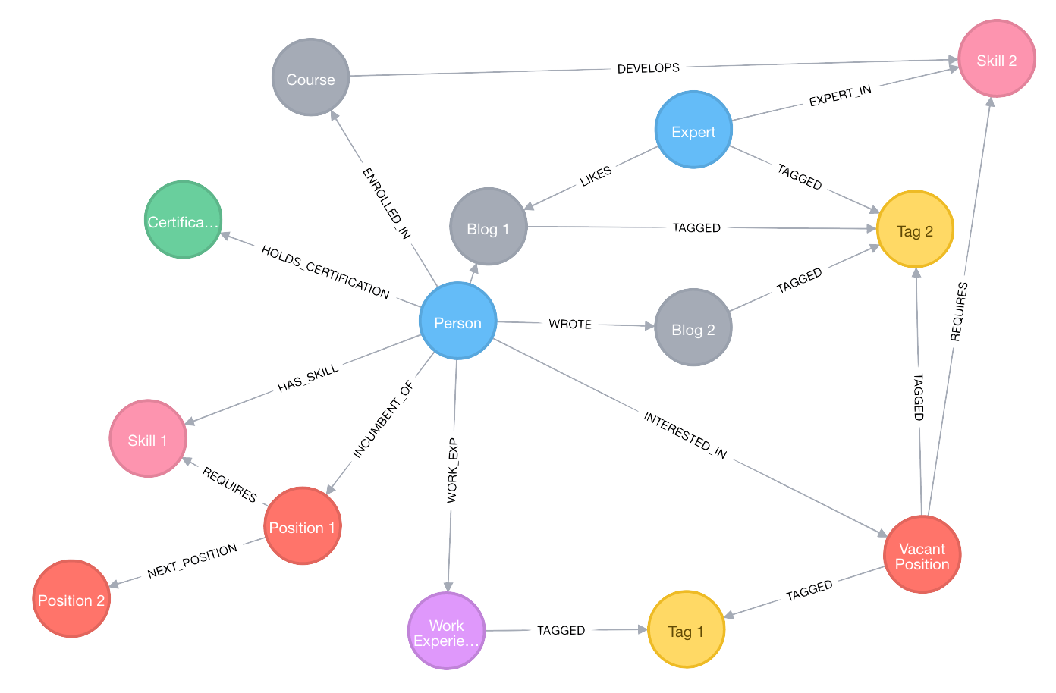
The Power of the Talent Graph
Talent Graphs enable Endorsements from Mentors, Colleagues, Bosses, etc., that are effectively Structured
Talent Graphs enable Big Data: Establishment of standards in matching against qualitative talent benchmarks
Talent Graphs enable Roadmapping <-> ROI calculations
Notes:
I switched order with last slide

Slide 7
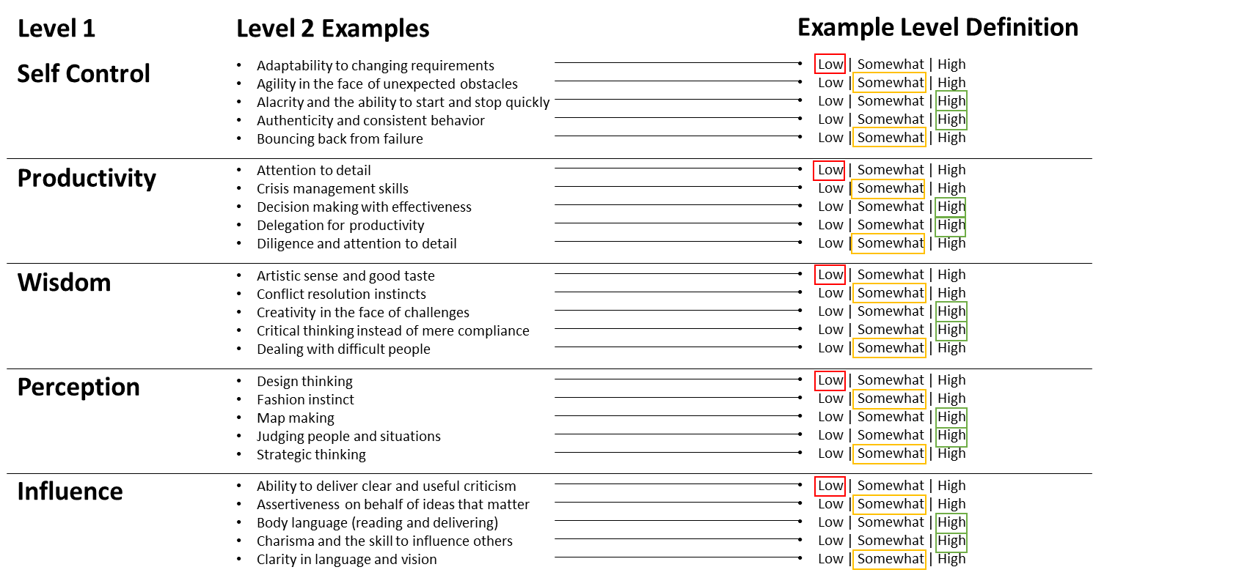
Structuring Skills via Talent Models in the Talent Graph
Talent Graphs combine Talent Models (Career Paths and Skill Trees) with Social Media and other data
For example, Management Consultancies typically have a 4-level Talent Model:
Analyst / Consultant
Consultant / Associate
Manager / Senior Associate
Senior Manager / Principal
Talent Graphs reveal a clear definition of WHAT are the critical skills of the future, based on Institutional Knowledge and/or Study.
Talent Graphs enable Endorsements from Mentors, Colleagues, Bosses, etc., that are effectively Structured
Talent Graphs enable Big Data: Establishment of standards in matching against qualitative talent benchmarks
Talent Graphs enable Roadmapping <-> ROI calculations
Talent Models are defined by institutions that develop them and certify their effectiveness on some basis.
Talent Models
Notes:
I switched order with last slide

Slide 8
Understanding a Talent Model: A Multi-Level Skill Tree with a Structured Rubric
This is a Sample Talent Model from Seth Godin, Founder of altMBA
Source: https://itsyourturnblog.com/lets-stop-calling-them-soft-skills-9cc27ec09ecb
Each Definition may have a detailed explanation, and on any number of scales – such as “Agree/Disagree” “1 of 10” etc.
Level 1
Level 2 Examples
Example Level Definition
Self Control
Adaptability to changing requirements
Agility in the face of unexpected obstacles
Alacrity and the ability to start and stop quickly
Authenticity and consistent behavior
Bouncing back from failure
Low | Somewhat | High
Low | Somewhat | High
Low | Somewhat | High
Low | Somewhat | High
Low | Somewhat | High
Productivity
Attention to detail
Crisis management skills
Decision making with effectiveness
Delegation for productivity
Diligence and attention to detail
Low | Somewhat | High
Low | Somewhat | High
Low | Somewhat | High
Low | Somewhat | High
Low | Somewhat | High
Wisdom
Artistic sense and good taste
Conflict resolution instincts
Creativity in the face of challenges
Critical thinking instead of mere compliance
Dealing with difficult people
Low | Somewhat | High
Low | Somewhat | High
Low | Somewhat | High
Low | Somewhat | High
Low | Somewhat | High
Structured Talent Models can be rationalized independently, or in terms of their market value. They can be linked to other Talent Models through Crowd Sourcing
Perception
Design thinking
Fashion instinct
Map making
Judging people and situations
Strategic thinking
Low | Somewhat | High
Low | Somewhat | High
Low | Somewhat | High
Low | Somewhat | High
Low | Somewhat | High
Influence
Ability to deliver clear and useful criticism
Assertiveness on behalf of ideas that matter
Body language (reading and delivering)
Charisma and the skill to influence others
Clarity in language and vision
Low | Somewhat | High
Low | Somewhat | High
Low | Somewhat | High
Low | Somewhat | High
Low | Somewhat | High
Talent Models are defined by institutions that develop them and certify their effectiveness on some basis.

Slide 9




Exploring the Product Opportunities in the Talent Graph
Story
360
Talent Graphs enable 360 Endorsements from Mentors, Colleagues, Bosses, etc., that are effectively Structured
Talent Graphs enable Big Data Matching: Establishment of standards in matching against qualitative talent benchmarks
Talent Graphs enable Vision: Roadmapping <-> ROI calculations
Match
Vision
Notes:
I switched order with last slide

Slide 10
Product Map Based on Talent Graph
Match provides Talent Graph-powered supply and demand selections that mask bias-producing data from the Administrator
360 utilizes Talent Graphs to give a user’s peers, mentors, bosses, etc., a structured way to Baseline their Talent
Vision provide What If’s and Line of Sight to ROI, based on Talent Graph investments and likely outcomes, fed by Big Data Sources
Stories leverage Social Media to provide a portfolio of ongoing and completed projects that credentialize 360 rankings
Stories
360
Match
Vision
Results in a Talent Market
Qualifies
Leverages Talent Models
Enhances
Talent Graph
Social Graph (e.g. LinkedIn)

Slide 11
Our Timeline
6/17 – Submission of Linkedin Data Analytics Proposal
7/21 – Completion of first draft of Data Strategy Plan
8/1 – Kickoff of Curriculum Utilization at MC2 Highschool in Cleveland
8/18 – Target Completion of second draft of Data Strategy Plan
10/1 – Target award of LinkedIn Data and Analysis Kickoff
12/1 – First insights from LinkedIn Data Analysis
12/1 – Target Kickoff of National PAL Curriculum National Distribution
2/1/18 - Target Executive Brief of Data Strategy Plan at major Social Media platforms, including Insights from LinkedIn Data

Slide 12
Day in the Life of the Talent Graph
1
2
Talented People with Limited-to-no Experience
University, Grant, or Hiring, Administrators
Applicant owns accounts in various social media that shows her involvements and achievements that may or may not reveal her political views, gender, and race, etc.
User’s 360 endorsements are structured based on Talent Model Skill Trees
User integrates Stories from other Social Media to credentialize their Skill Trees
User views Matches to jobs and opportunities knowing that the Administrator cannot bias their initial decision on political views, gender, race, etc.
User simulates their choices in “What If” analysis in Vision
New job or grant listing is placed
The opportunity is tied to specific Talent Graph Skills
Applicants are matched against Talent Graph, but their demographics are hidden
Early applicant decisions are made blind to anything other than structured data around the Talent Graph
Once certain milestones have been crossed, the Administrator is able to see the demographics of the applicants

Slide 13
Talent Graph Data Enrichment Processes
Stories leverage Social Media to provide a portfolio of ongoing and completed projects that credentialize 360 rankings
1. Stories
Supplement
2. 360
Powers
360 utilizes Talent Graphs to give a user’s peers, mentors, bosses, etc., a structured way to Baseline their Talent
Talent Graph
Talent Graphs are defined by institutions that develop them and certify their effectiveness on some basis.
Runs through
Match provides Talent Graph-powered supply and demand selections that mask bias-producing data from the Administrator
3. Match
Enriches
Predict
Vision provide What If’s and Line of Sight to ROI, based on Talent Graph investments and likely outcomes, fed by Big Data Sources
4. Vision

Slide 14
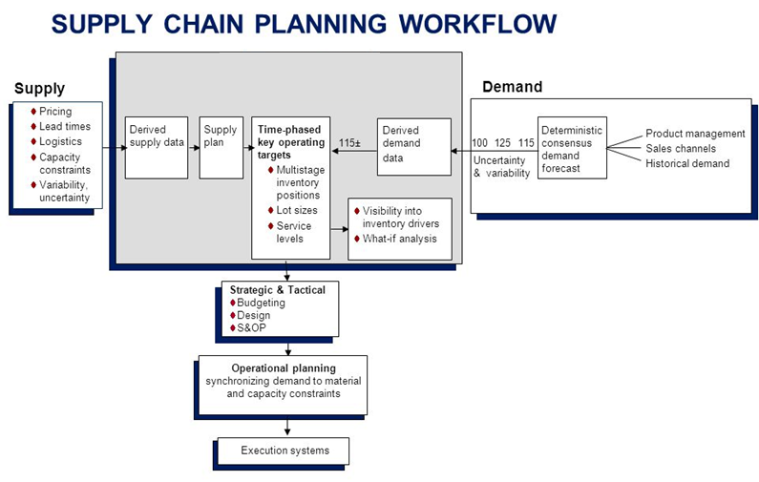
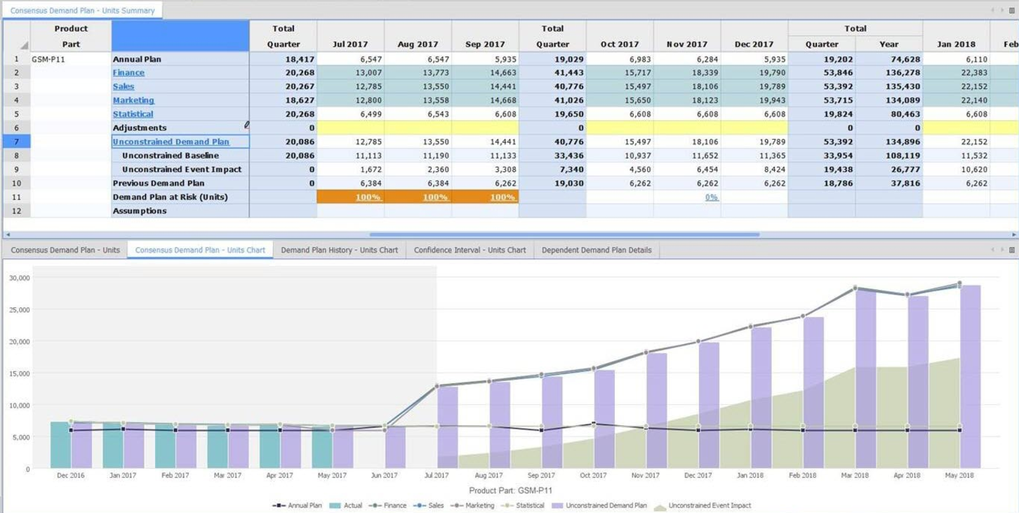
Vision Product Case Study: Supply Chain Management “Sandboxing The Future” –Supply Chain Performance Tools as Example
Example Supply Chain Performance Modeling
Example Supply Chain Planning What-If Outcomes Application
Example Insight for Vision Product: Leverage Talent Graph to Strategically Balance Supply and Demand in Talent Chain on an individual level, or even on an aggregate level
Example Insight for Vision Product: Provide Clear Line of Sight to Return on Investment for a user to take into account the Cost and Benefit Factors of pursuing talents and then leveraging them

Slide 15
The Talent Graph strategy is self-sustaining and self-fulfilling
1
Outcomes for Talented People with Limited-to-no Experience
Talent Graph-enriched Products
Value
Line of Sight to ROI
Merit-based Opportunity
Uncertainty in Career Choices
Uncertainty in Up-Skill Investment
New Talent Graphs
Talent Graph-enabled Users
Increased Talent Graph Density
2
Outcomes for University, Grant, or Hiring, Administrators
Increased Utilization of Talent Graph
Value
Workforce Talent
Cost
Risk

Slide 16
Summary
Formula
Ask
Trust = Credibility + Reliability + Intimacy
Credibility: Talent Graph-powered 360, coupled with Stories, to capture a holistic view of individual
Reliability: Using anti-bias, data driven, and self improved algorithm
Intimacy: Using Talent Graph to Vision one’s success and potential future
Result: Minimization of Self Orientation to Maximize Trust
Tbd

